Slide 1

CSE-5335: Presentation
GROUP - 5
Manisha Kankanampati - 1002063542
Manasa Kondapuram - 1002128586
Manohar kommi - 1002118103
Mounika kanneti - 1002032500
Tejasri Katikapally - 1002032909
Section: 5335-002
SUMMER 2023

Slide 2
URM APPLICATION
INTRODUCTION
The project's objective is to create a website that meets the requirements of academia, URM candidates, recruiters, and DEI officers. For PhD programs, postdoctoral jobs, and teaching vacancies, the website will offer a platform for academic institutions to access a list of possible URM candidates. Candidates from URM will have the chance to look up relevant universities and submit applications for faculty or postdoctoral positions. Recruiters can use the website to find qualified individuals, and DEI officers will be helped by it in identifying institutions and universities that lack diversity.
The homepage, registration and login process, academia dashboard, URM candidate profiles, search and filter choices, communication and collaboration tools, and a feedback and review system are some of the website's key features and elements. All these components come together to produce a complete platform that enables interaction, job searching, and collaboration between academia and URM candidates.

Slide 3
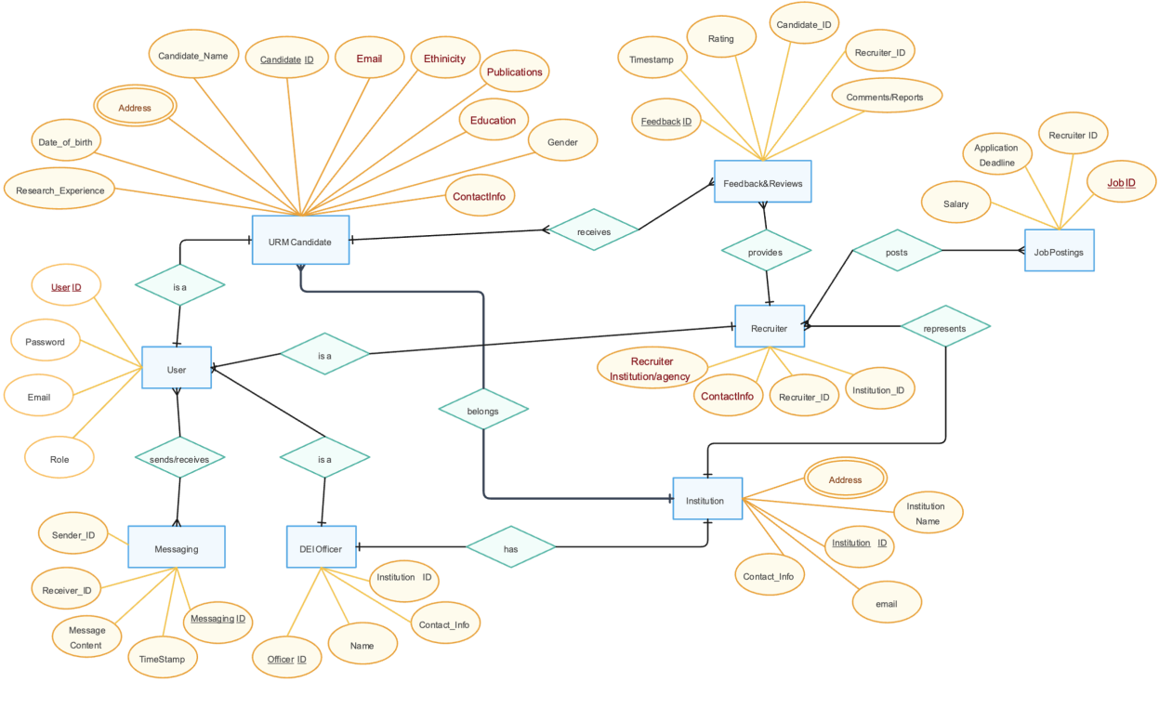
ER-DIAGRAM
ENTITY RELATIONSHIP DIAGRAM

Slide 4
TECHNOLOGIES AND LANGUAGES USED IN THE PROJECT
LANGUAGES:
1.HTML 2.CSS
3.JavaScript 4.React
5.Node.Js 6.MySQL
7.PHP 8.Laravel
TECHNOLOGIES:
1.Word Press to create the BLOG for our website

Slide 5
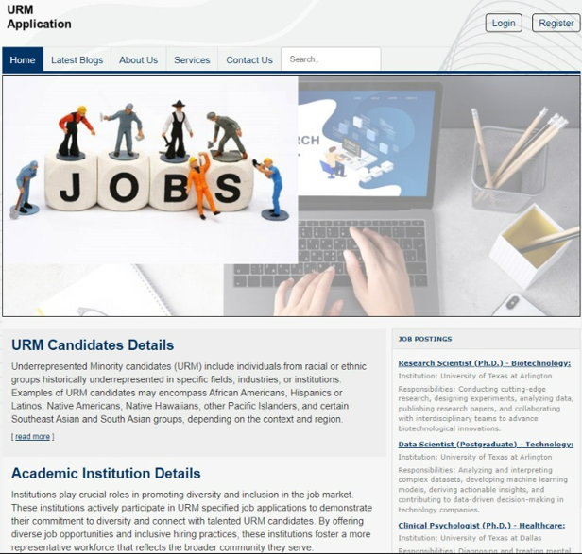
PAGES DESIGNED FOR OUR WEBSITE
URM APPLICATION
The Pages Before Login:-
The pages before the Login are :
1.Home
2.Latest Blogs
3.About Us
4.Services
5.Contact us and
6.Login/register page
These are the pages which helps
to Navigate the Basic overview of
our website.

Slide 6
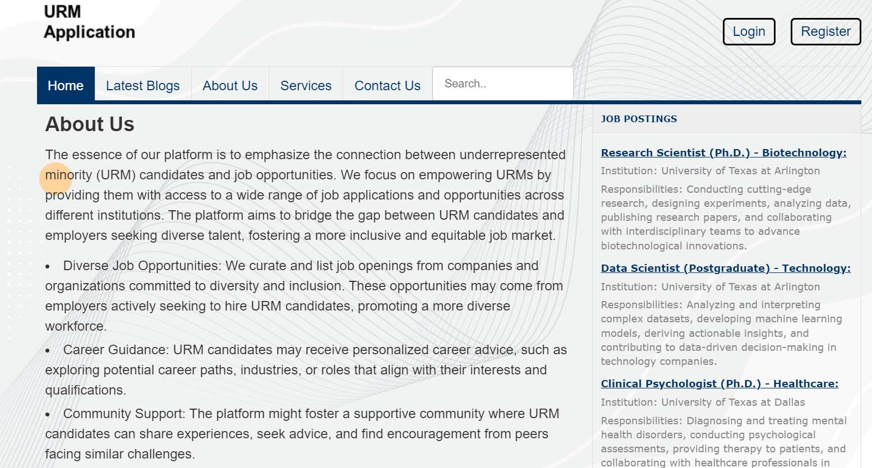
ABOUT US PAGE
This page provides information regarding the URM Application .
How does application helps for different users

Slide 7
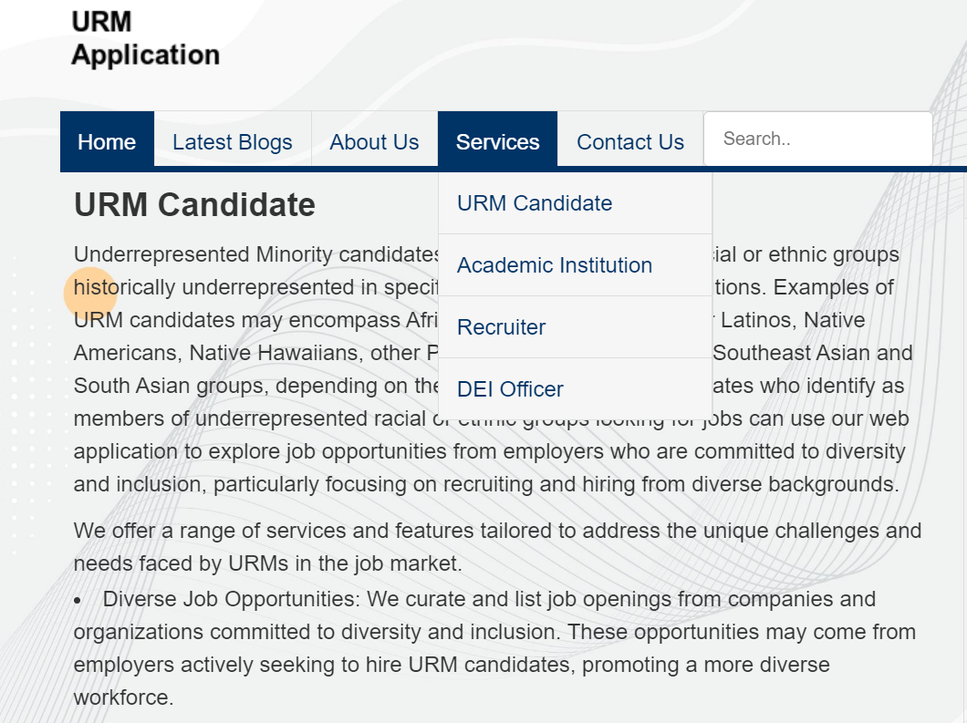

SERVICES
Services page helps user to navigate to
4 user profiles they are :
URM Candidate
Academic Institution
Recruiter
DEI Officer
Selecting any of them can
lead to the respective
profiles and their dashboards.

Slide 8
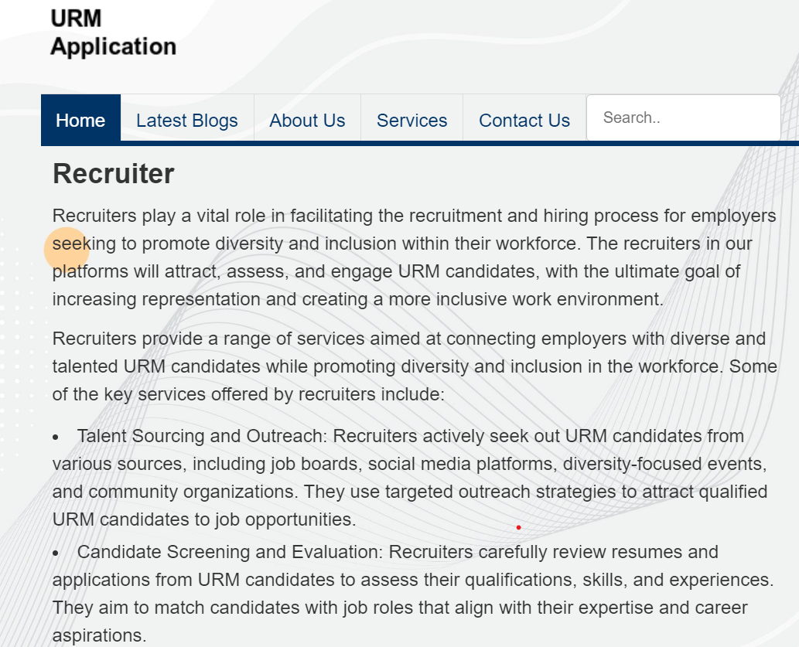
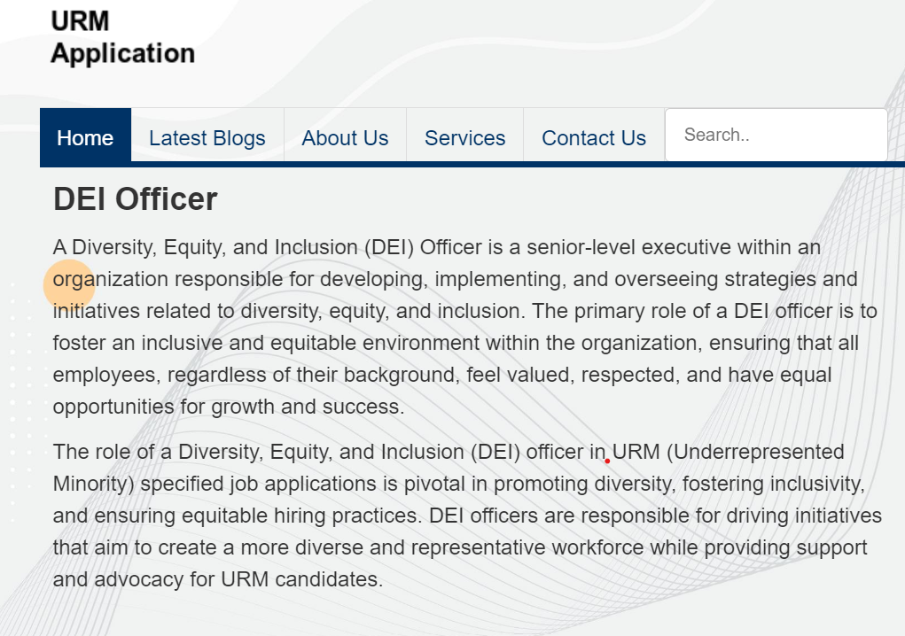
SERVICE CONT..

Slide 9
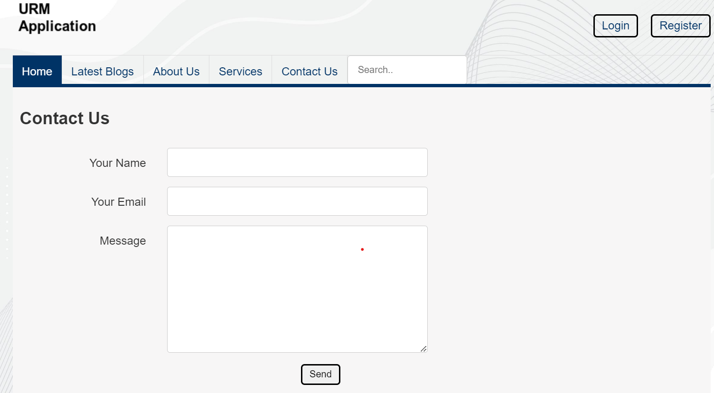
CONTACT US PAGE
Here CUSTOMERS/USERS can contact us if they have any questions about our website by providing their basic details like user name, email address and message.

Slide 10
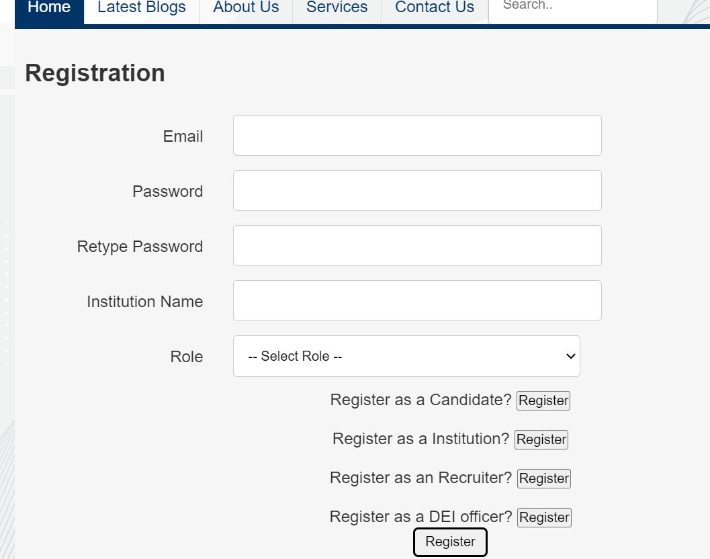
REGISTRATION PAGE
Initially user have to register using
registration form
For registering we need to give the
Email ID with a password which need to
satisfy the conditions ,Institution Name
and Role
Once registered we can login to the website .
Before login we have to register.
User can register with their respective
profiles by clicking on register button .

Slide 11
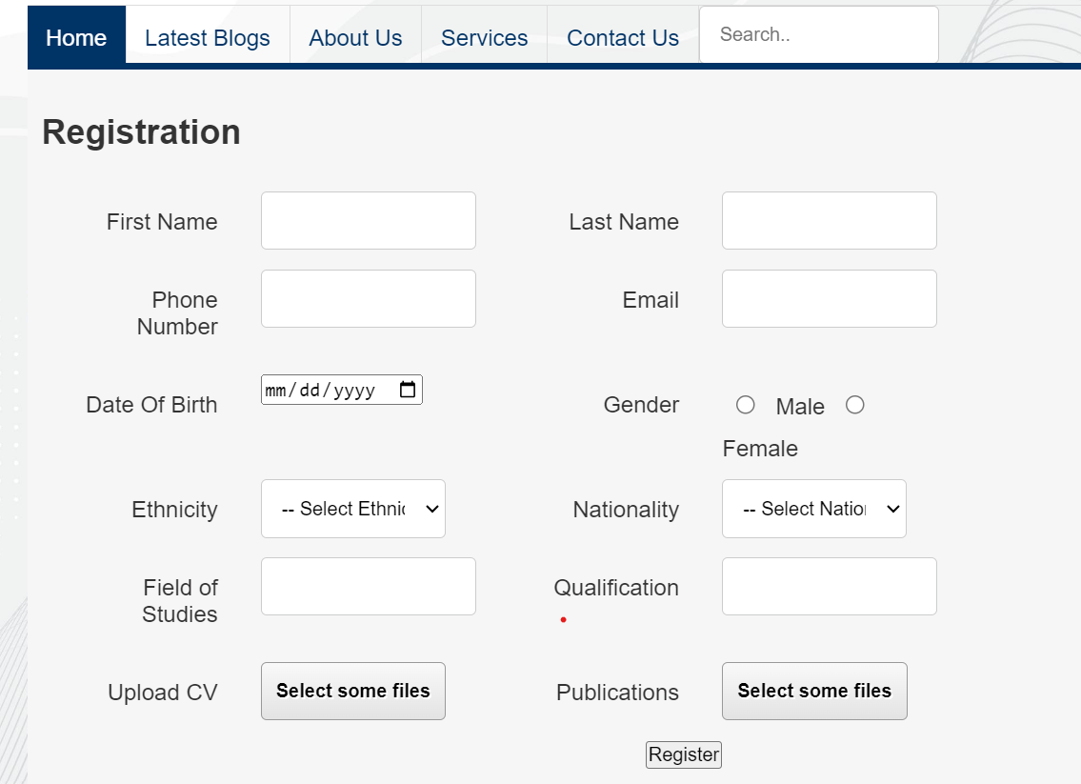
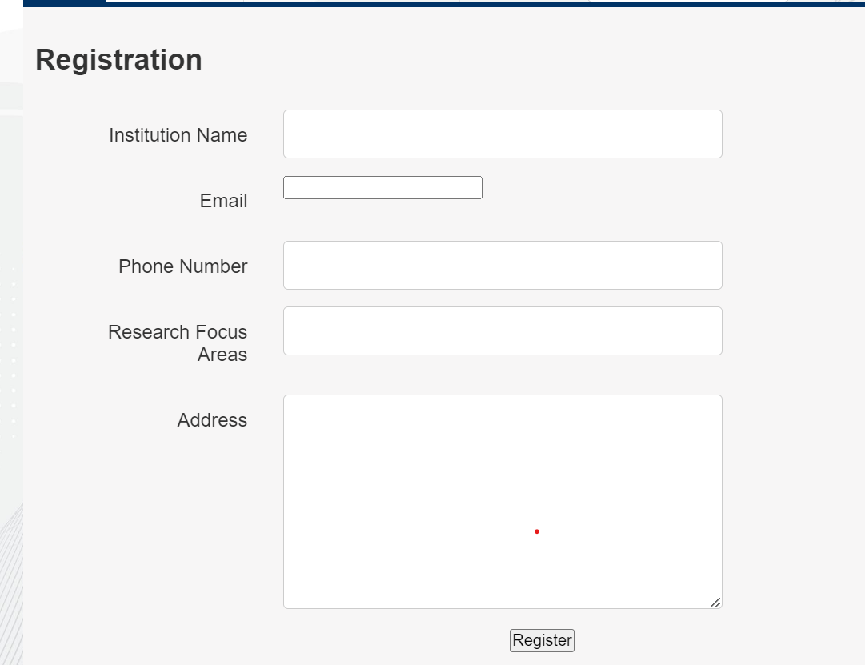
CANDIDATE & INSTITUTION REGISTER PAGE
Candidate user can register
using candidate registration form
by providing basic details in
order to login likewise with
institution registration page.

Slide 12
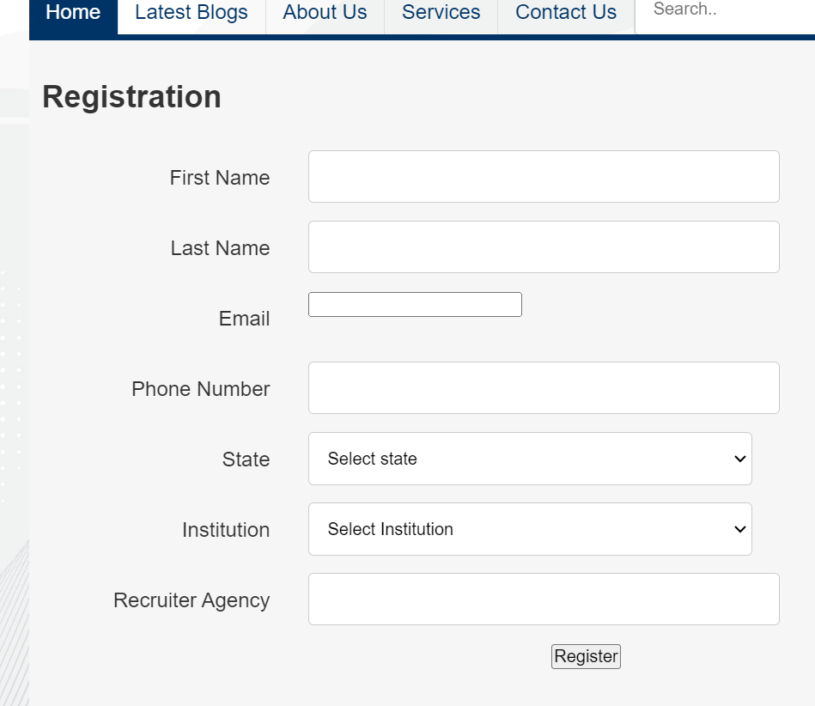
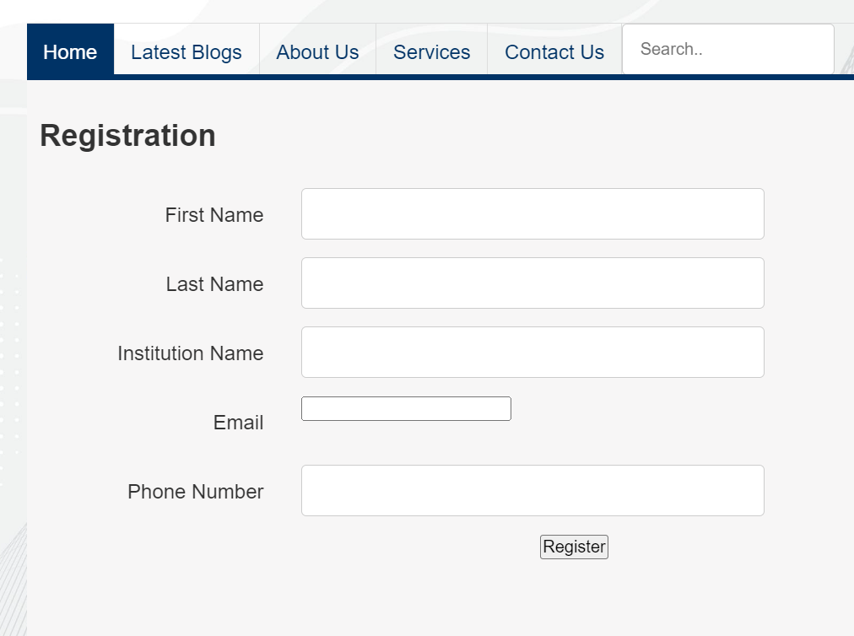
RECRUITER AND DEI OFFICER REGISTER PAGE
Recruiter and DEI Officer
Can register using these pages
To login into their respective
profiles

Slide 13
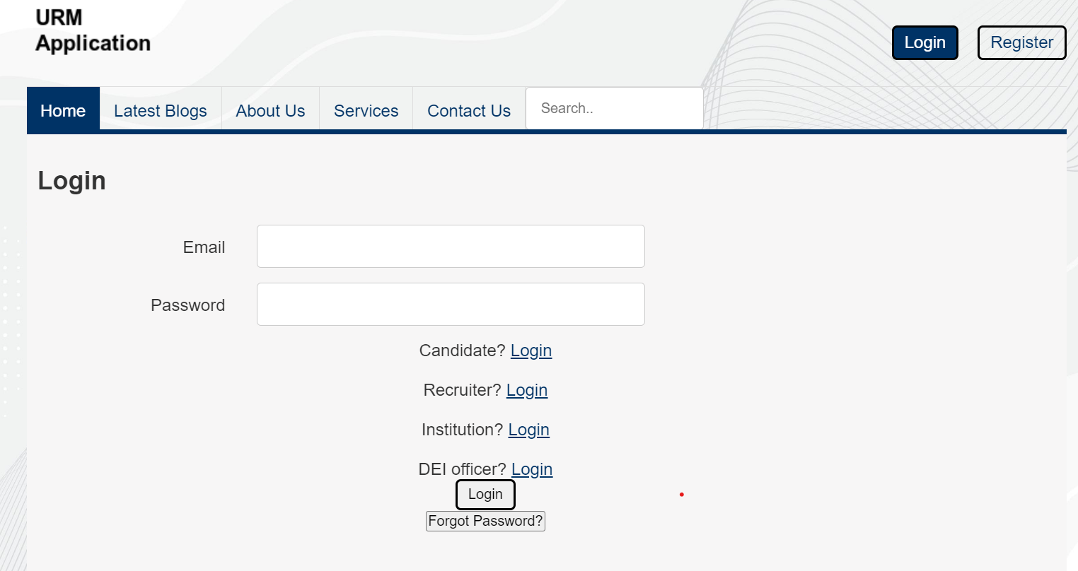
LOGIN PAGE
The login page have login block where
a user have to login and there is logins.
In login page:-
After login using the email id
and Password. we have different
pages like.
1.Candidate Page
2.Recruiter Page
3.Institution Page
4.DEI officer Page

Slide 14
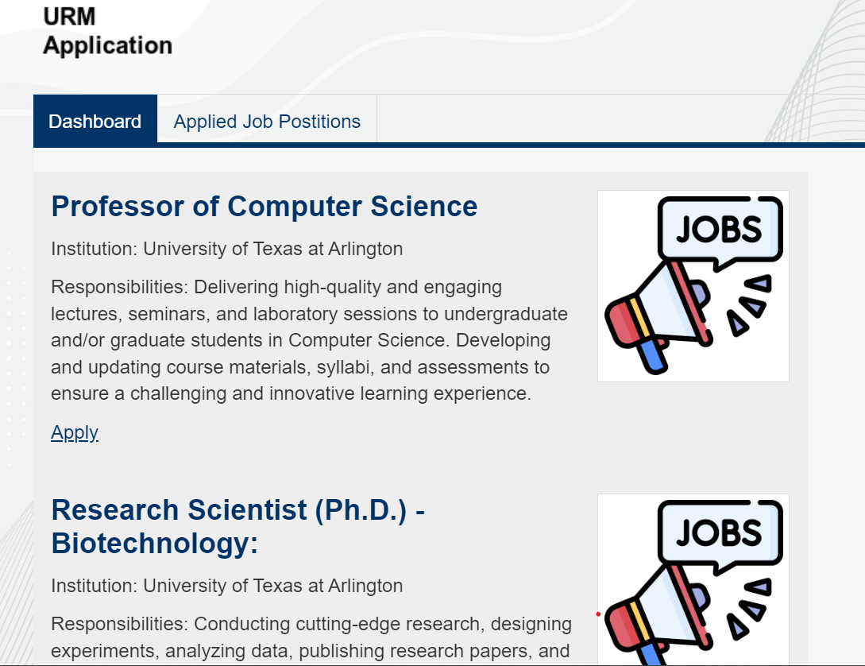
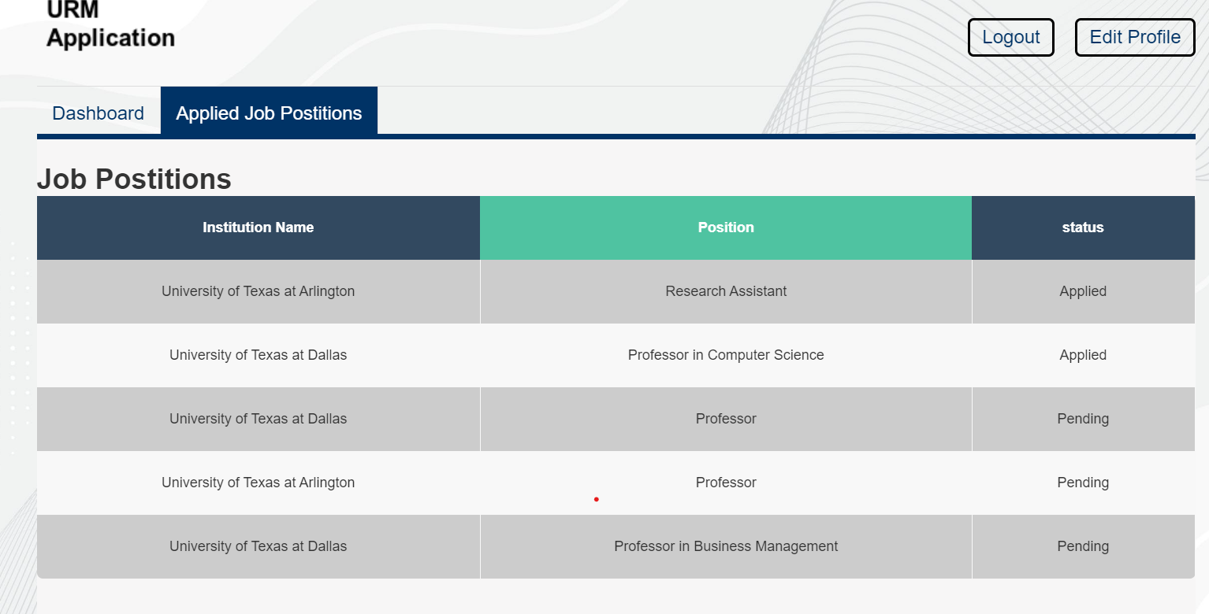
CANDIDATE LOGIN PAGES
After login ,Candidate user can view their dashboards and applied job position tabs.
Applied job positions tab gives complete information of the institution name, position and the status of the candidate that applied for.

Slide 15
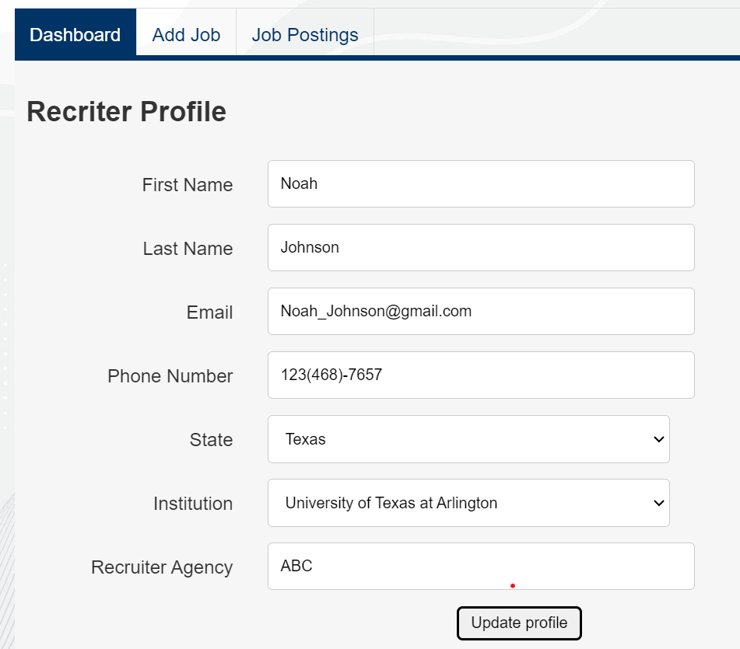
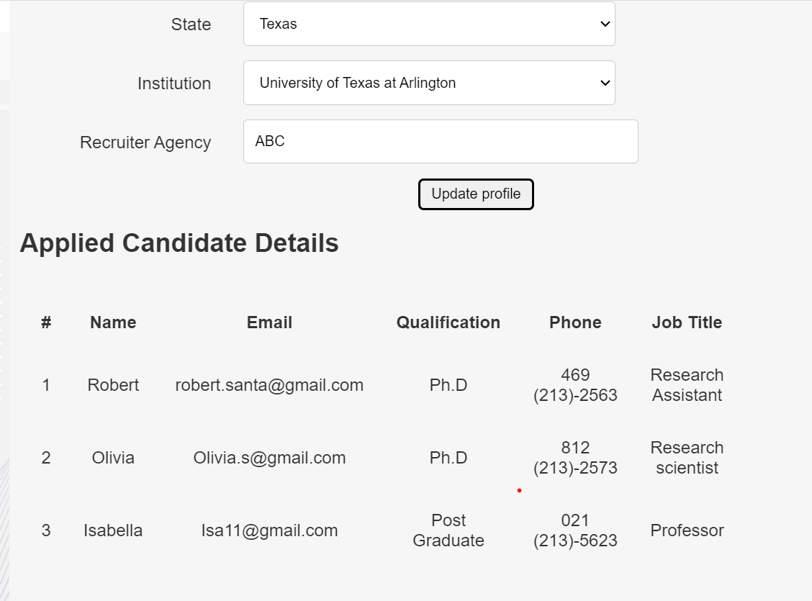
RECRUITER PAGE
Recruiter user can look for dashboard, adding job and job postings in this page.
User can view applied candidate details as well.

Slide 16
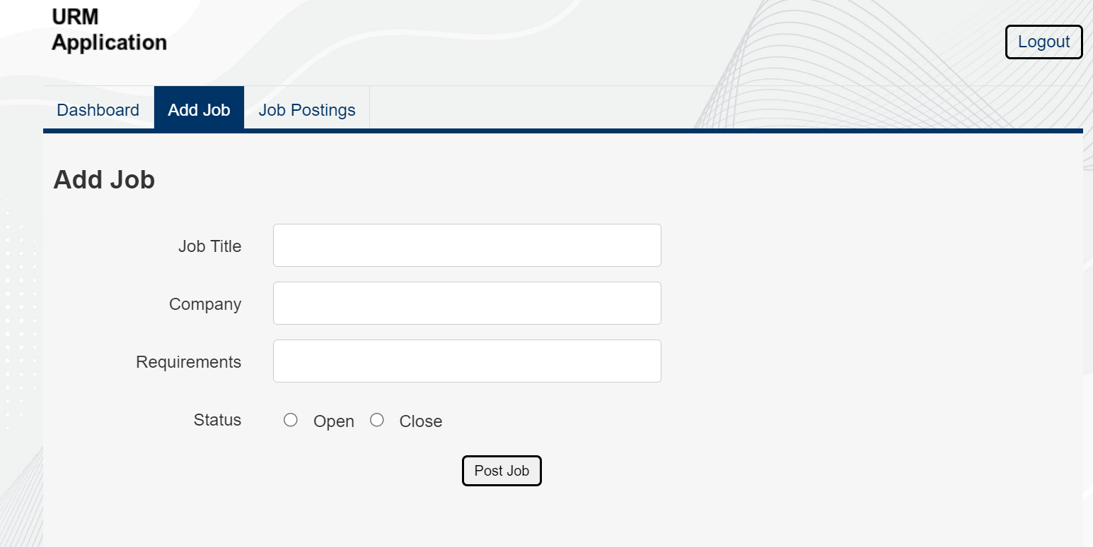
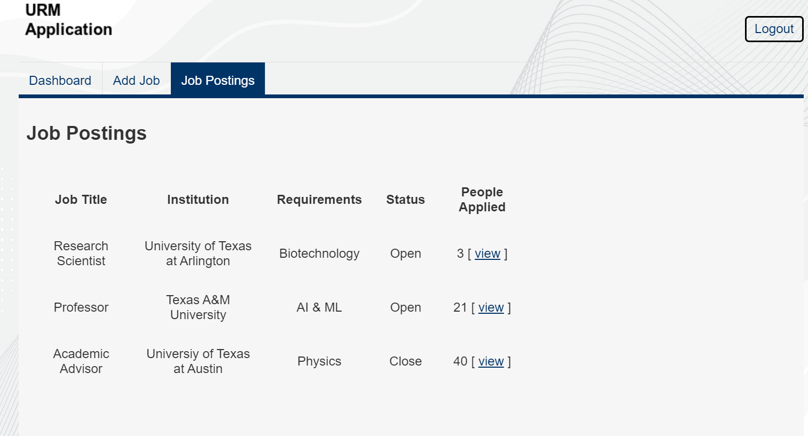
RECRUITER PAGE CONT..
Recruiter can add new jobs if there are any by giving job details and can view job postings and its status.

Slide 17
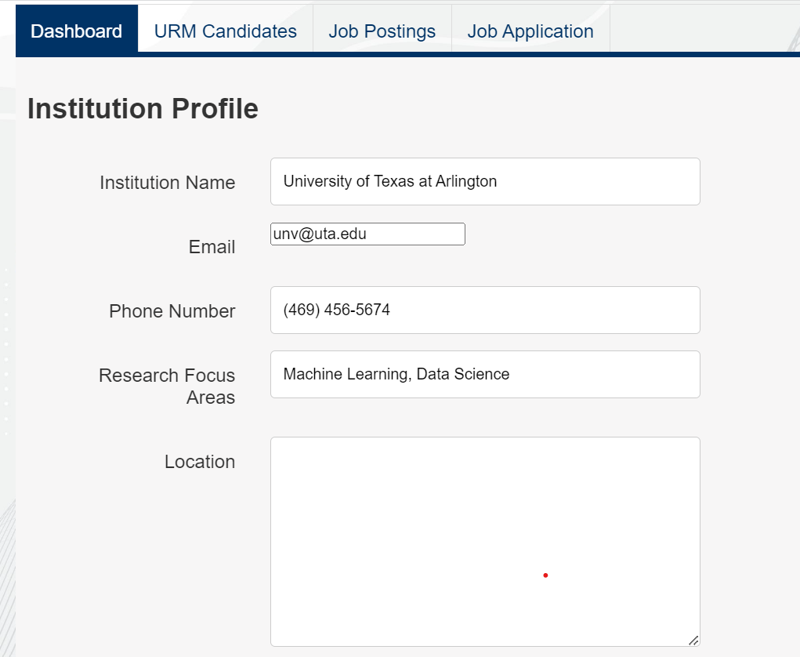
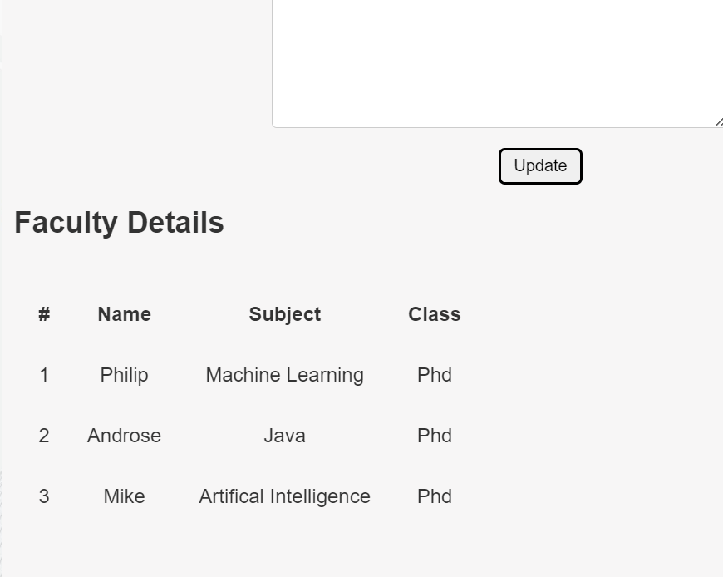
INSTITUTION LOGIN
It has institution dashboards, candidate information, job postings, application for jobs.
Can update faculty details using update button.
Can post jobs and check for applications of candidates .

Slide 18
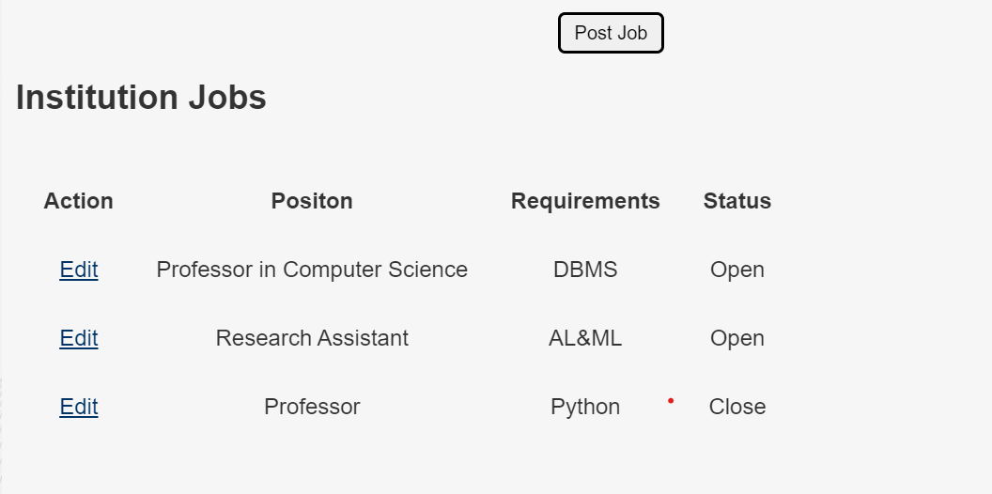
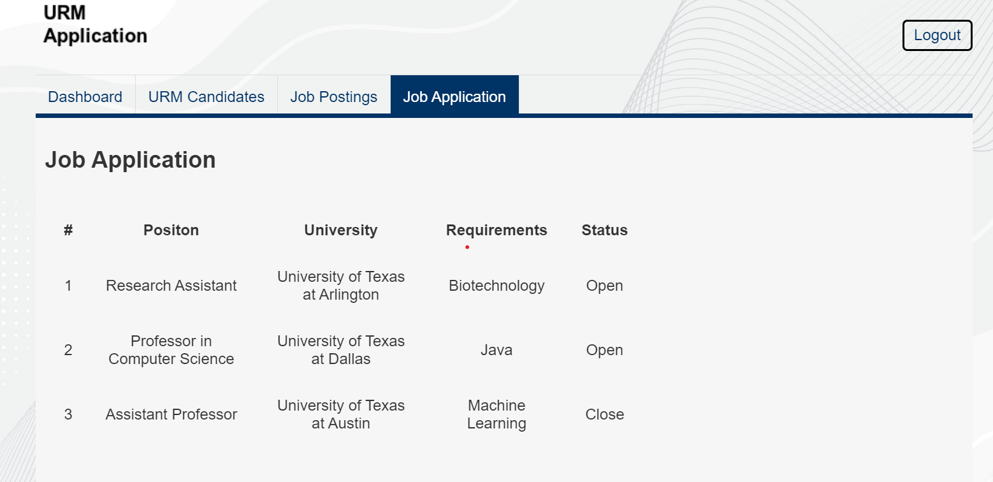
INSTITUTION LOGIN PAGE CONTI..

Slide 19
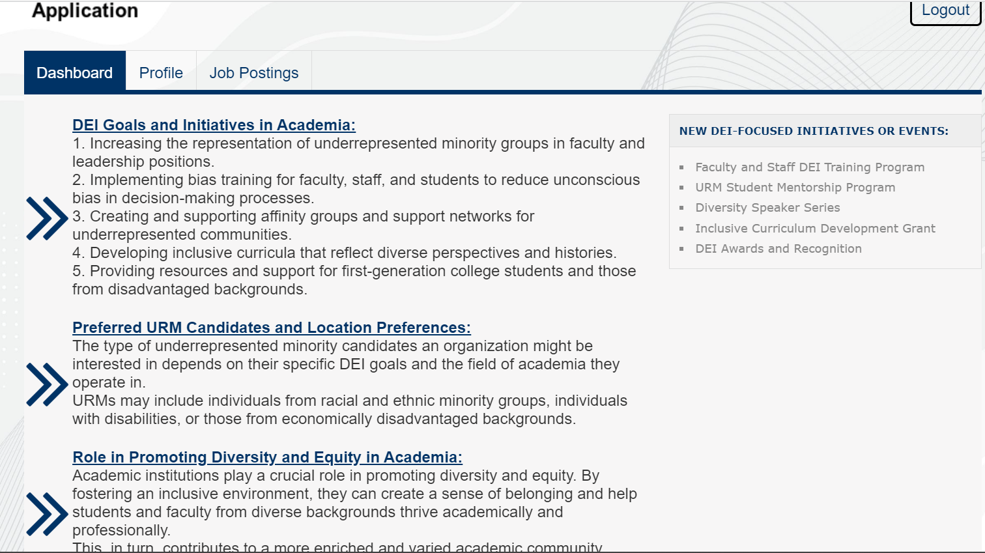
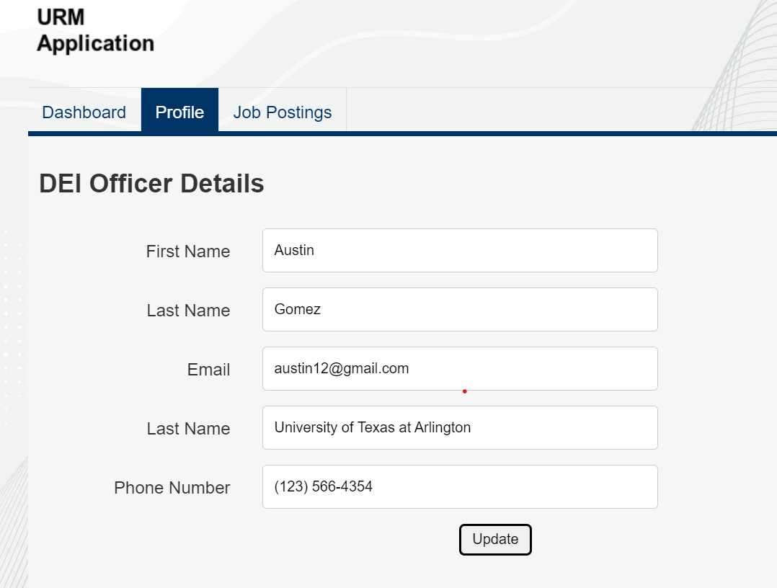
DEI OFFICER PAGE
DEI can view their dashboard, profile and job postings through this page
Can update profile, view job postings and status

Slide 20
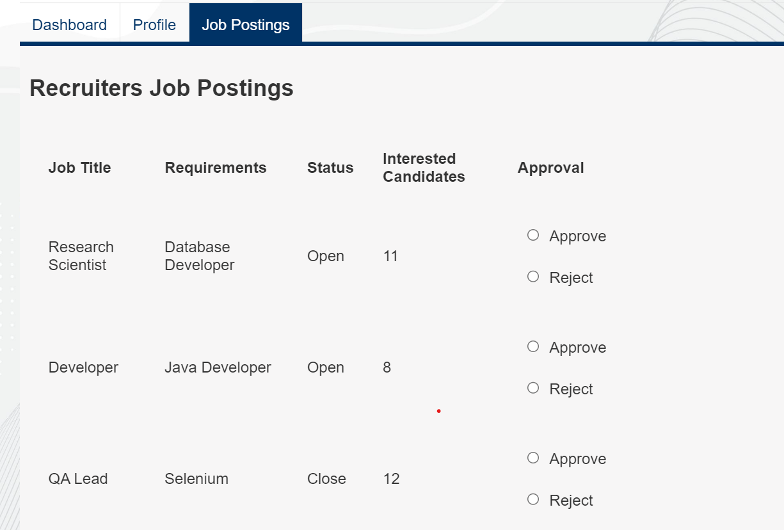
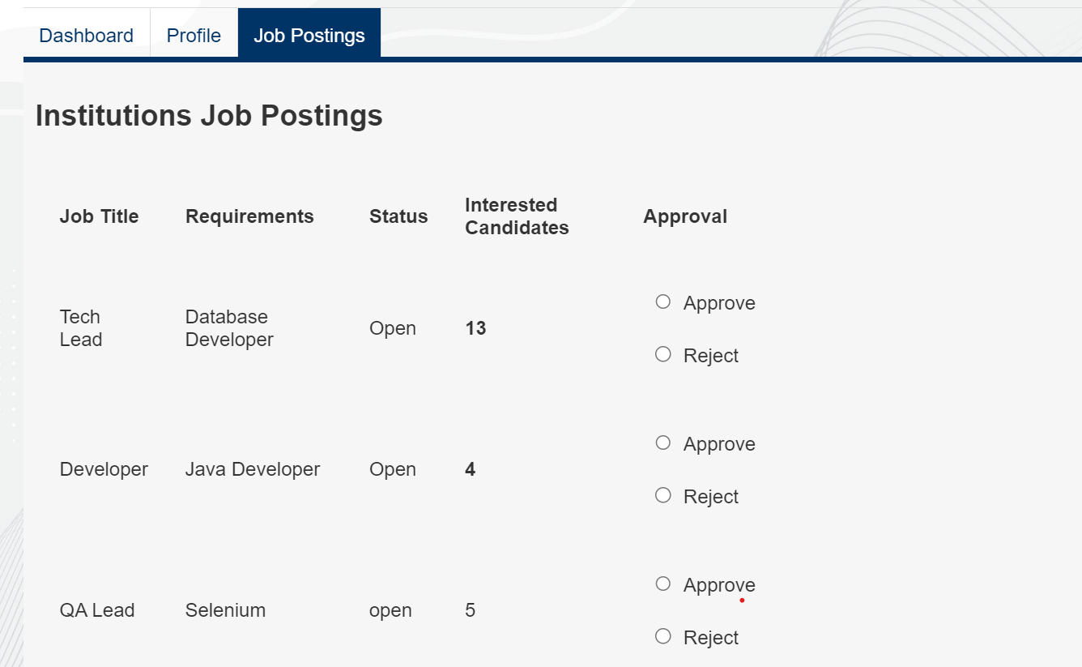
DEI OFFICER PAGE CONTI..

Slide 21
Challenges Faced
Deploying code into Cloud -
phase3 node deployment was challenging and we weren’t able to make db connection from cloud.
- We resolved it in phase 4 with-----
Creating the web application in short duration is a challenging task where there are lot of web pages to modify in each phase but we were able to manage within stipulated time as a team.
Working with multiple technologies like HTML, CSS, Node.js, PHP(Laravel) were challenging, as few of the team members are not familiar with all of them. This required additional training to get proficiency in that technology.
Implemention of chat functionality - We did lot of research to get this properly done using multiple resources from google.
Faced an issue of redirection from React application to blog ,later resolved by modifying code in .htaccess file.

Slide 22
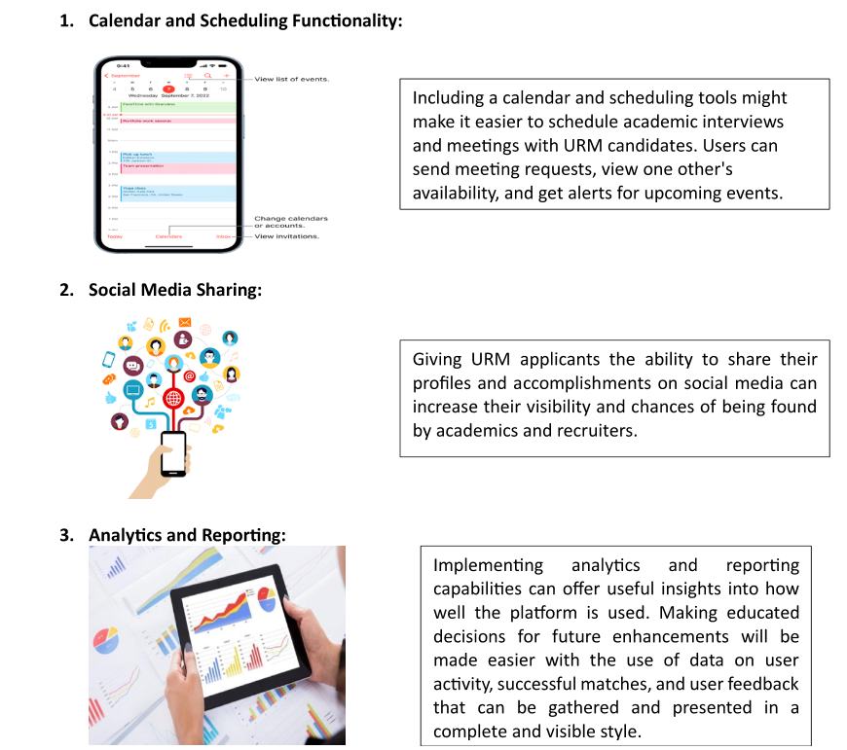
Creative Functionalities
We Planned to implement
these functionalities but
couldn’t implement due to
time constraint

Slide 23
Improvements
Web Responsiveness of pages can be done more effectively
Implementation of creative functionalities we mentioned

Slide 24
Future Addition to your Portfolio

Slide 25

Thank You

